Slide 1
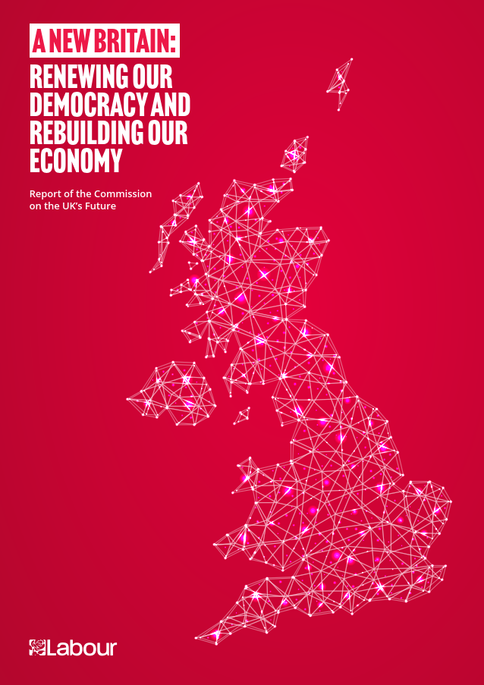

Slide 2
Britain’s Decade of Stagnation
Stagnating Incomes
Stagnating Health Services
Stagnating Education
1980’s
1990’s
2000’s
2010’s
Median Household Income Annual Growth
Incremental Life Expectancy at Birth (F)
5+ GCSE-Equivalent Passes %pt Growth

Slide 3
The UK’s regional economic imbalance is uniquely large amongst major economies
Causes
1.66x
GVA per Worker (2016-20 Average) – Ratio of 80th to 10th Percentile
OECD Countries with at least 10 NUTS3 Regions
1.56x
1.51x
1.46x
1.47x
1.41x
1.39x
1.32x
1.27x
1.28x
1.28x
1.24x
1.26x
1.23x
1.23x
1.23x
1.23x
1.17x
1.19x
1.15x
1.16x
1.16x
1.17x
1.13x
1.13x
1.08x
1.10x
Sweden
Finland
Czechia
Norway
Slovenia
Spain
Japan
Hungary
France
Denmark
Austria
Germany
USA
Portugal
Belgium
Netherlands
New Zealand
Italy
Switzerland
Bulgaria
HR
South Korea
Poland
UK
Lithuania
Greece
Romania

Slide 5
Who’s trusted?
Which of the following groups of people do you trust most to have your best interests at heart? Please rank your top three. Included in top three
 | England | Labour 19 | England Swing |  | Scotland | Middle Scotland |  | Wales
#1 | Local councillors | Local councillors | Local councillors |  | Local councillors | Local councillors |  | Local councillors
#2 | Directly elected city/regional mayors | Trade union leaders | Directly elected city/regional mayors |  | Members of the Scottish Parliament/ Senedd | Members of the Scottish Parliament/ Senedd |  | Members of the Scottish Parliament/Senedd
#3 | School governors | Directly elected city/regional mayors | School governors |  | Trade union leaders | Trade union leaders |  | School governors
#4 | Civil servants | School governors | Trade union leaders |  | Directly elected city/regional mayors | Civil servants |  | Trade union leaders
#5 | Trade union leaders | Civil servants | Civil servants |  | Civil servants | Directly elected city/regional mayors |  | Directly elected city/regional mayors
#6 | Members of Parliament | Members of the House of Lords | Members of the House of Lords |  | School governors | School governors |  | Civil servants
#7 | Members of the House of Lords | Members of Parliament | Members of Parliament |  | Members of Parliament | Members of Parliament |  | Members of Parliament
#8 |  |  |  |  | Members of the House of Lords | Members of the House of Lords |  | Members of the House of Lords

Slide 6
The most centralised system of government
Central Government Tax & Spend in OECD (Bubble Size = Population)
United Kingdom
Central control of Taxation (% of Total Tax Collected
Poland
Italy
France
Mexico
Belgium
Denmark
Spain
Finland
Sweden
Germany
United States
Increasing Political Centralization
Switzerland
Australia
Canada
Americas/Australia
Europe
UK
Central Government share of Spending (% Total Government Spending)

Slide 7
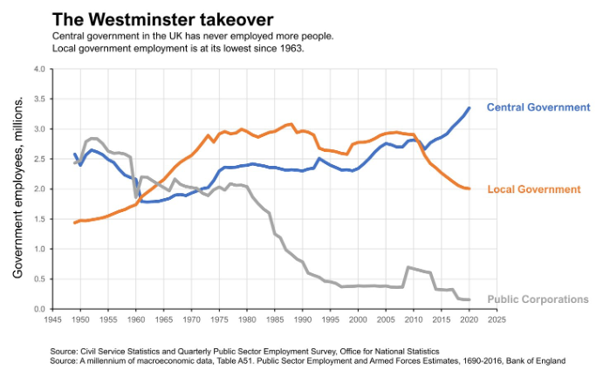

Slide 8
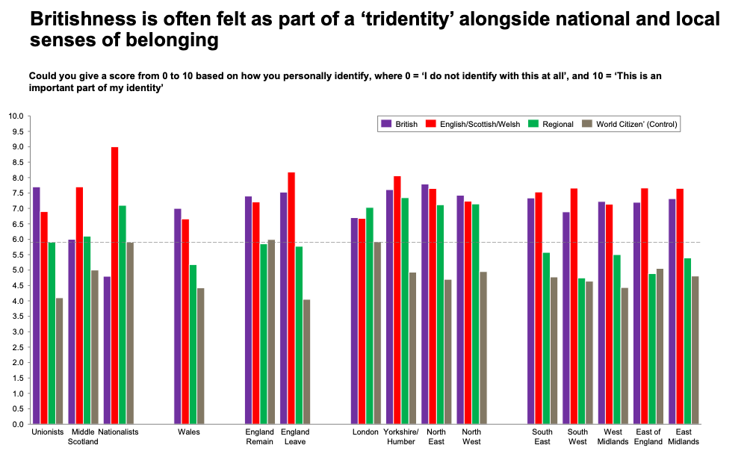

Slide 9
Some constitutional recommendations
The political, social, and economic purposes of the UK as a Union of Nations to be stated in a new constitutional statute to guide how political power should be shared within it.
A requirement to require decisions to be taken as close possible to the people affected by them
A requirement to respect the autonomy of local government
A requirement to rebalance the UK’s economy
Plus new, constitutionally protected, social rights

Slide 10
The right powers in right places
New economic powers for towns and cities in England to drive growth locally
Reformed economic development programmes, replacing EU regional funds
An economic growth plan for every town and city
The UK Infrastructure Bank to address regional inequality in infrastructure.
The British Business Bank to bridge the equity finance gap outside London and SE
50,000 civil service jobs and more Public Bodies HQs transferred out of London
Longer-term financial certainty and more revenue capacity for local government.
Localities to take new powers from the centre, through a new, streamlined process to initiate Special Local Legislation in Parliament.
Support for ”Double devolution”, pushing power closer to people

Slide 11
Scotland
Constitutionally protection for devolution by strengthening the Sewel Convention and through the new second chamber.
Scottish Government able to enter into international agreements and join international bodies in relation to devolved matters.
MSPs to have the same protections as MPs in relation to statements made Parliament
Strengthened cooperation with the UK Government
Devolution of JobCentre network
The British Regional Investment Bank to support innovation, with with the SNIB and EIB.
Case for pushing power closer to people in Scotland, and for directly elected Mayors.

Slide 12
Shared government: making cooperation work
A legal obligation of co-operation between the different levels of Government and institutions across the UK.
A Council of the Nations and Regions based in law, with an independent Secretariat
Joint policy initiatives proposed, from climate change to security
International trade policy to be more inclusive of devolved leaders
All UK departments and public bodies to make space in their governance for national and regional representation
Respect areas of decision making that are England only

Slide 13
Reform of Second Chamber
A constitutional moment.
Not whole new written constitution (for which no consensus) but major shifts of political and economic power, irreversibly entrenched
So abolish (indefensible) House of Lords and replace with a new, much smaller, elected chamber
  “Assembly of Nation and Regions”
Given the role of protecting key constitutional provisions, notably devolution, by rejecting legislation breaching them

Slide 14
Assembly of Nations and Regions
200 members, directly elected on regional basis
Different electoral system and cycle from Commons – exactly how for consultation
  Option of indirect participation by some devolved legislators
Different role from Lords
  Power to reject legislation (as today for extending term of Parliament)
  Only if relates to specified constitutional laws, as judged by Supreme Court
    Eg Sewel Convention, strengthened
    Option of making subject to Commons override by eg 2/3 majority
“Entrenchment” of constitutional rules
  Govt no longer do “whatever it likes”

Slide 16
Director’s Cut.. Social rights
Health: Every person legitimately present in the UK will be entitled to healthcare free at the point of need wherever they are in any part of the UK; no person shall be denied emergency treatment.
Education: every child shall be entitled to free primary and secondary education, wherever they are in any part of the UK
Poverty; So that no child, family or elderly citizen need live in poverty, every person legitimately present in the UK shall be entitled to social assistance in relation to periods of unemployment, disability or old age, in accordance with the relevant laws. No person shall be left destitute.
Housing: every person shall be entitled to decent accommodation, in accordance with the relevant law relating to housing and homelessness.

Slide 17
Main recommendations on “cleaning up” politics
Keep foreign money out of politics
Ban on second jobs for MPs, with only very limited exceptions
Ministerial code on ethics to be independent of Prime Minister
Prime Minister’s ethics advisor to be replaced by new Ethics Commission independent of government
Annual “Citizens Jury” to oversee whether system has built public trust
Anti-corruption Commissioner
Merge Commissioner on Public Appontments with Civil Service Commsisoner

Slide 18
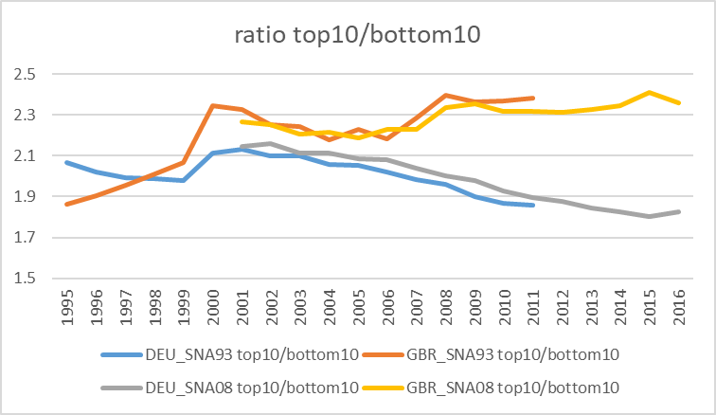
And getting worse, compared with, eg, Germany

Slide 19
This inequality is well-known by everybody – most people believe that geography is more important than talent when it comes to success
Causes
Which of the following factors do you think are most important in deciding how financially successful someone is in Britain?
Ranked by % in Top 3
Increasing Gap vs London
 | London | South East | Scotland | East of England | South West | North West | West Midlands | East Midlands | Yorkshire and The Humber | Wales | North East
#1 | Their level of education | Their level of education | Their level of education | How hard they work | Their level of education | Their level of education | Their level of education | Their level of education | Their level of education | Their level of education | Their level of education
#2 | How hard they work | How hard they work | Their parents’ wealth | Their level of education | How hard they work | Where they live | How hard they work | Where they live | Their parents’ wealth | Their parents’ wealth | Where they live
#3 | Where they live | Their parents’ wealth | How hard they work | Their parents’ wealth | Their parents’ wealth | How hard they work | Where they live | How hard they work | Where they live | How hard they work | How hard they work
#4 | Their parents’ wealth | Where they live | Where they live | Where they live | Where they live | Their parents’ wealth | Their parents’ wealth | Their parents’ wealth | How hard they work | Where they live | Their parents’ wealth
#5 | Their home environment | Their home environment | Their innate talents | Their innate talents | Their innate talents | Their home environment | Their innate talents | Their home environment | Their home environment | Their home environment | Their innate talents
#6 | Their innate talents | Their innate talents | Their home environment | Their home environment | Their home environment | Their innate talents | Their home environment | Their innate talents | Their innate talents | Their innate talents | Their home environment
#7 | Their ethnicity | Their ethnicity | Their ethnicity | Their ethnicity | Their ethnicity | Their gender | Their ethnicity | Their ethnicity | Their ethnicity | Their ethnicity | Their friends
#8 | Their friends | Their gender | Their gender | Their gender | Their friends | Their ethnicity | Their friends | Their gender | Their gender | Their friends | Their ethnicity
#9 | Their gender | Their friends | Their friends | Their friends | Their gender | Their friends | Their gender | Their friends | Their friends | Their gender | Their gender
Family &
Connections
Geography
Identity
Character
Education

Slide 20
In England, Economic Devolution will ensure that the key ingredients of growth are put in the hands of every community
Recommendations
 | Key Recommendations
Infrastructure & Transportation | Devolved Control and funding of local bus services Local Leaders to shape local rail services, fares, and timetables Devolving stable, longer-term infrastructure budgets Enhanced compulsory purchase powers UK Infrastructure Bank mandated to reduce regional economic inequality
Ingenuity & Skills | Devolution of 400+ Job Centres Devolution of 200+ Further Education Colleges as part of general skills policy devolution Removing barriers for new local authority provision of childcare
Investment Capital | British Business Bank to become British Regional Investment Bank Additional mandate to provide equity capital to scale-up businesses in partnership with private investors outside of London/South East Initial financing from sale of Wind/telecoms/other public concessions
Incentives for Business | UK Life Sciences Industrial Strategy unit to enable ‘innovative procurement’ of new therapies outside of current EU-written procedures – similar to the COVID Vaccine Greater encouragement to use procurement system to generate wealth within communities
Innovation & R&D Funding | Direct involvement of local/regional authorities in a strengthened Strength in Places Fund
New Mechanisms for ‘Devolution as Standard’ (vs lengthy bespoke deals)
A Plan for Every Place
  Bringing together neighbouring local authorities or combined authorities behind a single growth plan
  (No new layers of government without public consent)
Greater Fiscal Power
  Long-term minimum budget certainty will allow in-year operating investment
  Other local tax powers to be announced by Shadow Chancellor
Legislative Power
  Streamlined right to take power from Westminster – no longer waiting for the ministry to get round to it
Community Power
  Community right to buy
  Community right to consultation on heritage assets
  Deliberative/participatory democracy
Devolving on the
Supply Side
Reorientating Investment
to Clusters

